Slide 1
The SOLID Principles

Slide 2
Context
5 Principles of OO Design
‘Collected’ by Robert Martin (Uncle Bob) early 2000s

Slide 3
Code will change
Rigid: Cascade of changes
Fragile: Unexpected breakages
Immobile: Entangled, can’t reuse
Viscous: Hard to do the right thing

Slide 4
Code will change
Rigid: Cascade of changes
Fragile: Unexpected breakages
Immobile: Entangled, can’t reuse
Viscous: Hard to do the right thing
Related to dependency management

Slide 5
What we’d like
Flexible
Robust
Reusable
‘Pit of success’

Slide 6
What we’d like
Flexible
Robust
Reusable
‘Pit of success’
Principles that highlight poor code

Slide 7
Some gotchas
Various (competing) definitions
Lots of misunderstanding & misconceptions
Lots of confusion (eg DIP and DI)
Can’t prove adherence, can only prove violation

Slide 8
Single Responsibility Principle

Slide 9
Single Responsibility Principle
A module should have one, and only one, reason to change

Slide 10
Single Responsibility Principle
public class Account
{
public bool Withdraw(int amount) …
public void Print() …
public void Save() …
}

Slide 11
Open/Closed Principle

Slide 12
Open/Closed Principle
You should be able to extend a module’s
behaviour, without modifying it

Slide 13
Open/Closed Principle
public class AreaCalculator
{
public double Area(object[] shapes)
{
double area = 0;
foreach (var shape in shapes)
{
if (shape is Rectangle)
{
Rectangle rectangle = (Rectangle) shape;
area += rectangle.Width*rectangle.Height;
}
else
{
Circle circle = (Circle) shape;
area += circle.Radius*circle.Radius*Math.PI;
}
}
return area;
}
}

Slide 14
Open/Closed Principle
public abstract class Shape
{
public abstract double Area();
}
public class AreaCalculator
{
public double Area(Shape[] shapes)
{
double area = 0;
foreach (var shape in shapes)
{
area += shape.Area();
}
return area;
}
}

Slide 15
Liskov Substitution Principle

Slide 16
Liskov Substitution Principle
Derived classes must be substitutable for
their base classes

Slide 17
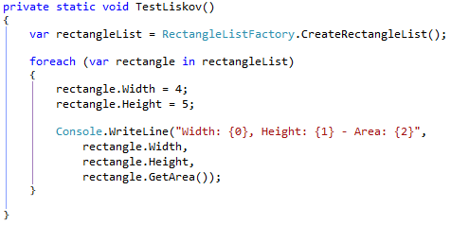
Liskov Substitution Principle

Slide 18
Interface Segregation Principle

Slide 19
Interface Segregation Principle
Make fine grained interfaces that are client
specific

Slide 20
Interface Segregation Principle
public interface IMachine
{
void Print();
void Staple();
void Scan();
void PhotoCopy();
}

Slide 21
Interface Segregation Principle
public interface IPrinter
{
void Print();
}
public interface IStapler
{
void Staple();
}
public interface IScanner
{
void Scan();
}
public interface IPhotoCopier
{
void PhotoCopy();
}
public interface IMachine : IPrinter, IStapler, IScanner, IPhotoCopier
{}

Slide 22
Dependency Inversion Principle

Slide 23
Dependency Inversion Principle
Depend on abstractions, not on concretions

Slide 24
Dependency Inversion Principle
High-level modules should not depend on low-level modules. Both should depend on abstractions
Abstractions should not depend upon details. Details should depend upon abstractions

Slide 25

Dependency Inversion Principle
http://code.tutsplus.com/tutorials/solid-part-4-the-dependency-inversion-principle--net-36872

Slide 26
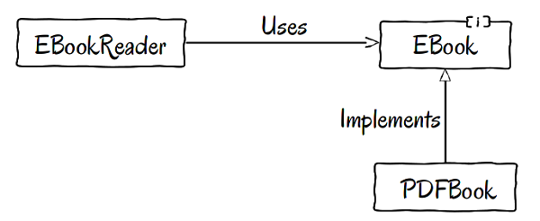
Dependency Inversion Principle
http://code.tutsplus.com/tutorials/solid-part-4-the-dependency-inversion-principle--net-36872

Slide 27
Great Destination Terrible Roadmap Can’t prove adherence, can only prove violation

